Slide 1

TOUR PLANNER
Your Tour Our Plan

Slide 2
Tour Planner
. • It is an application where a user can plan his/her tour, book ticket for bus, can also book hotel depending on budget. When a user plan a tour our system will tell the weather condition of that place, our system also provides books to the user to pass their free time and there will also have a chat-bot where a user can plan his/her tour very easily.
. • Sometimes it happens that we make a plan for tour and on that day we found that the weather condition is not good on that place, if the condition is good still sometimes we faces many problems due to local politics, strike and so on. Sometimes backpacker travelers may on tide budget and they face problem to find hotel and food on their budget. Here our system will provides all these information with some offer price depending on season.

Slide 3
Information Gathering:
Benchmark Analysis 🗸
Similar article review 🗸
Research paper 🗸
Similar organization visit ✘
Survey 🗸
Interview ✘
JAD meeting ---(N/A) ✘

Slide 4
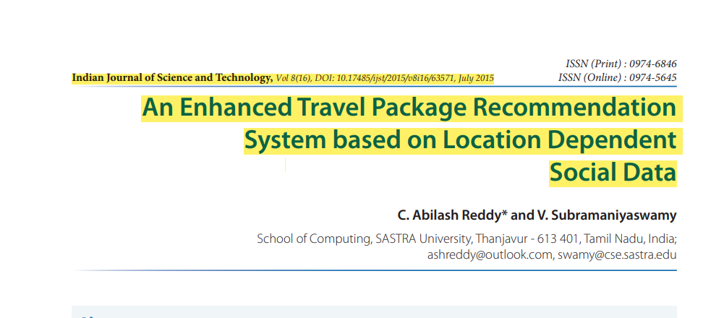
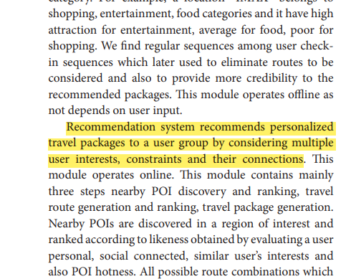
Research Papers Reviewed:

Slide 5
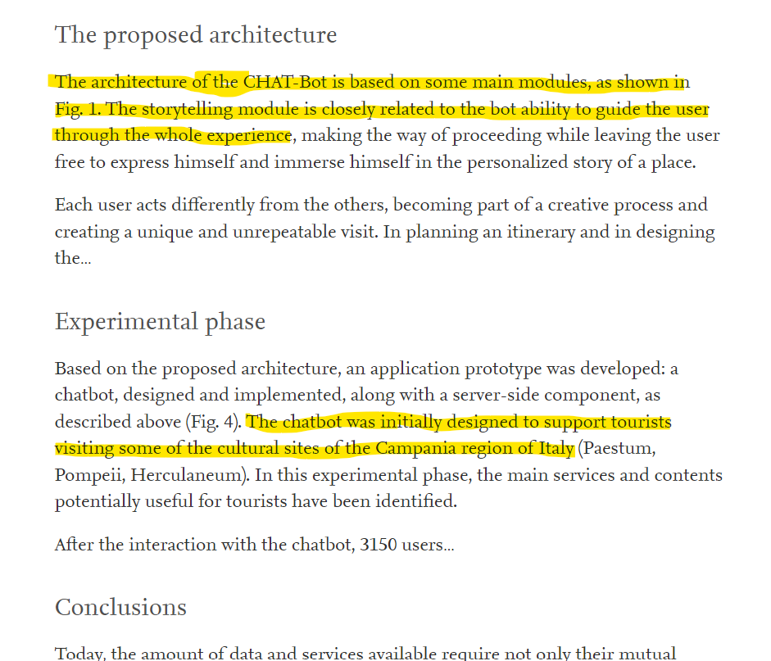
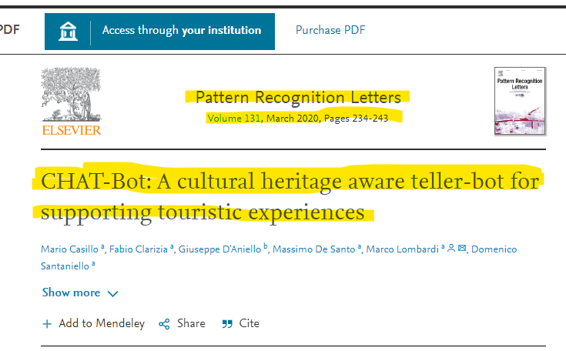
Research Papers Reviewed:

Slide 6






BenchMark Analysis : Similar Website/ App according to our project.

Slide 7
BenchMark Analysis : Similar Website/ App according to our project.
Similarities:
Tour suggestion
Bus ticket
Hotel book
Travel package recommendation
Limitations:
Weather info
Free time utilization
Chat bot

Slide 8
BenchMark Analysis : Similar Website/ App according to our project.
Similarities:
Tour suggestion
Bus ticket
Hotel book
Travel package recommendation
Limitations:
Weather info
Free time utilization
Chat bot
Blog

Slide 9
BenchMark Analysis : Similar Website/ App according to our project.
Similarities:
Tour suggestion
Bus ticket
Hotel book
Travel package recommendation
Limitations:
Weather info
Free time utilization
Chat bot
Blog

Slide 10

BenchMark Analysis : Similar Website/ App according to our project.
Similarities:
Tour suggestion
Buss ticket
Hotel book
Travel package recommendation
Limitations:
Weather info
Chat bot
Blog

Slide 11
BenchMark Analysis : Comparison
 | ShareTrip | Booking.com | Wanderlog | Kayak | Urbanaut | Gozayaan | Tour Planner
Tour suggestion | Yes | Yes | Yes | Yes | Yes | Yes | Yes
Weather condition | No | No | No | No | No | No | Yes
Bus ticket | Yes | Yes | Yes | Yes | Yes | Yes | Yes
Hotel ticket | Yes | Yes | Yes | Yes | Yes | Yes | Yes
Reading books while traveling | No | No | No | No | No | No | Yes
Chatbot | No | No | No | No | No | No | Yes
Travel package recommendation | Yes | Yes | No | No | Yes | Yes | Yes
E-card | Yes | No | No | No | Yes | Yes | No

Slide 12
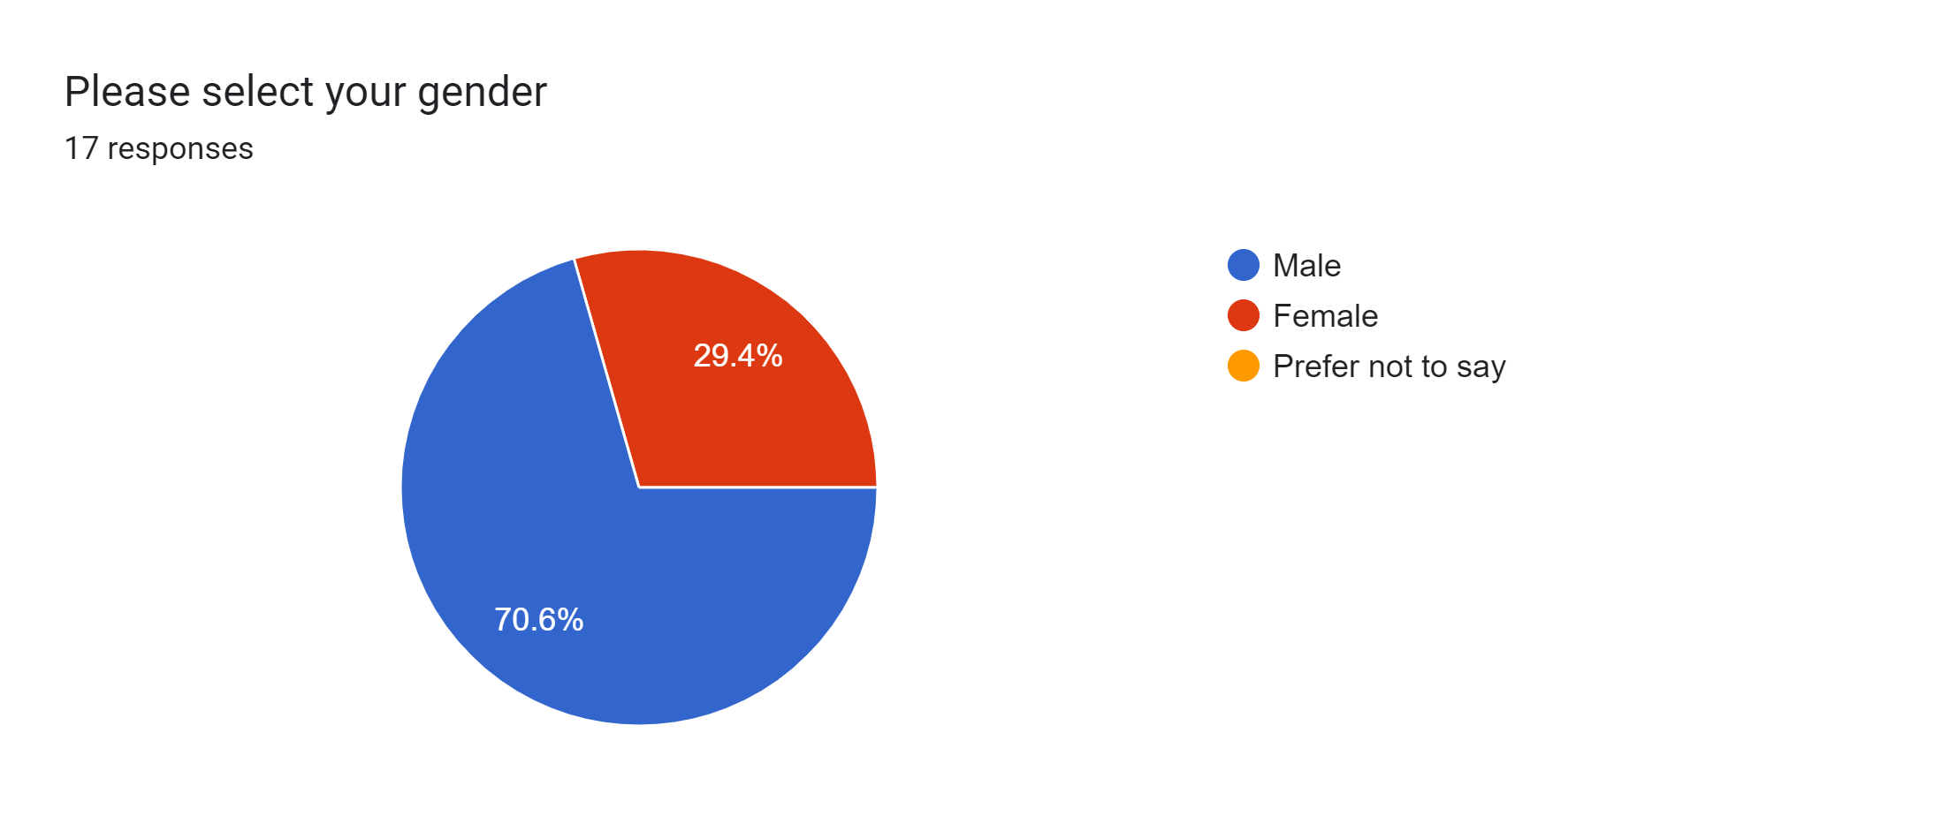
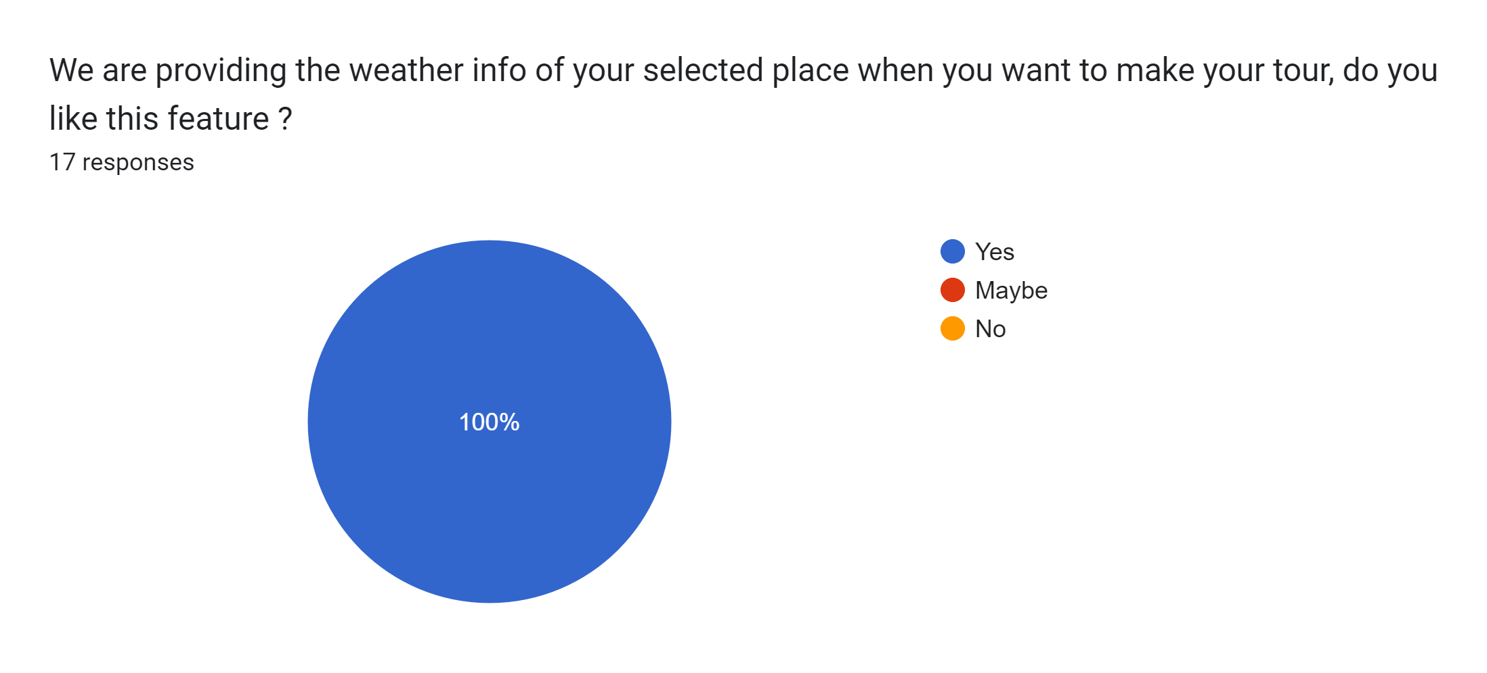
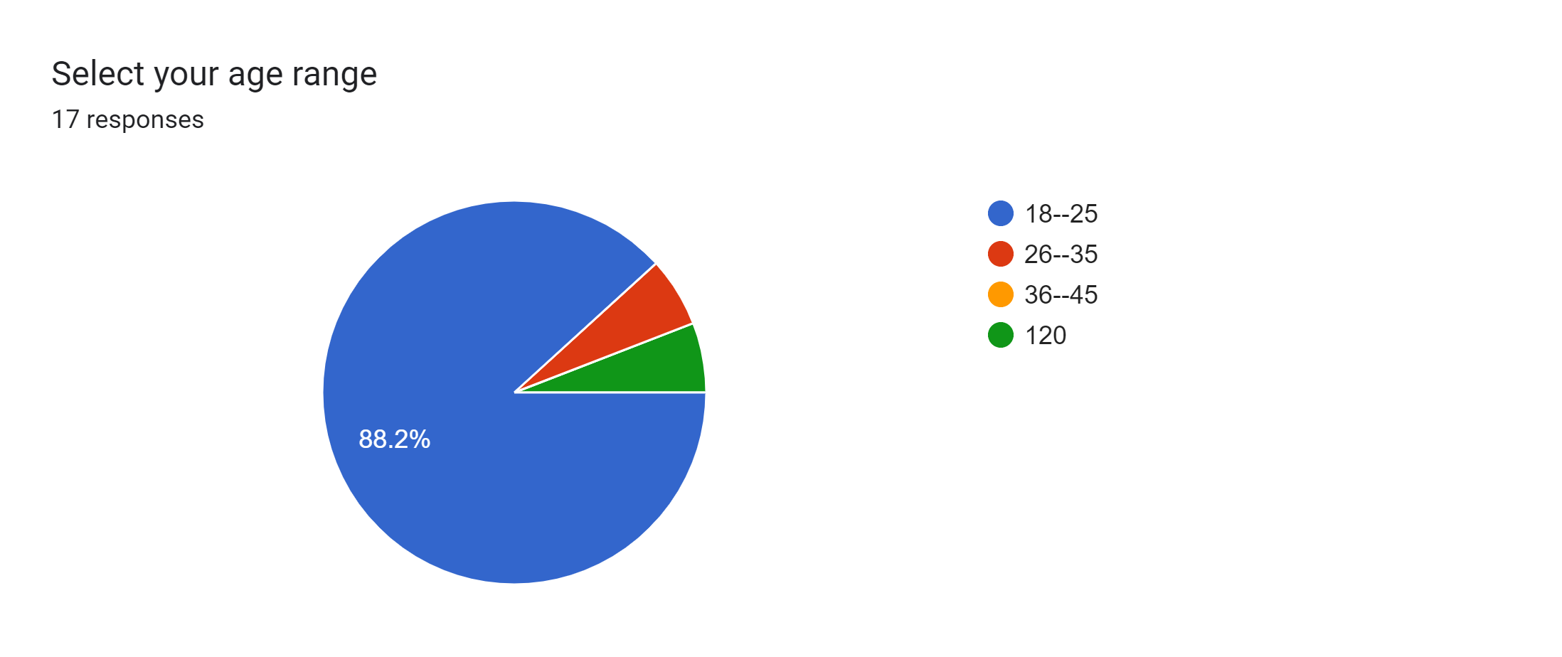
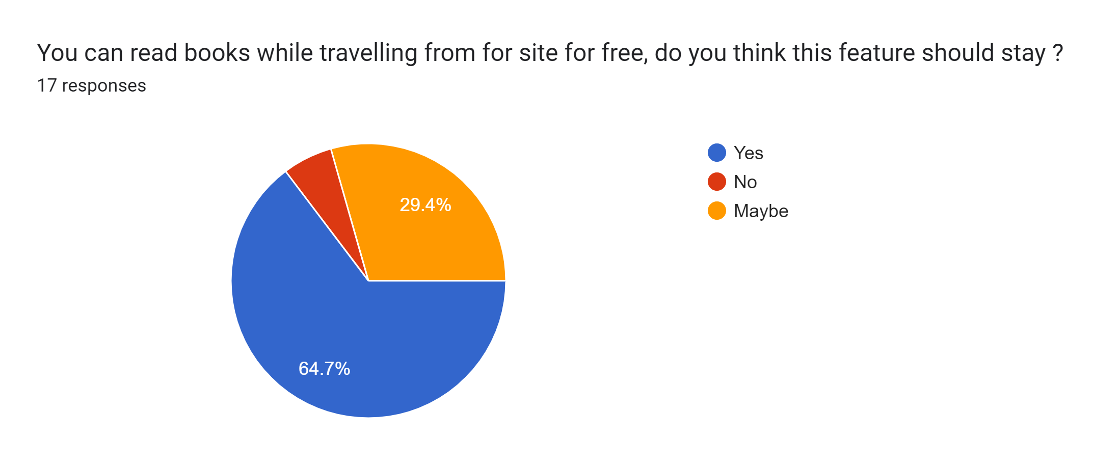
Survey:

Slide 13
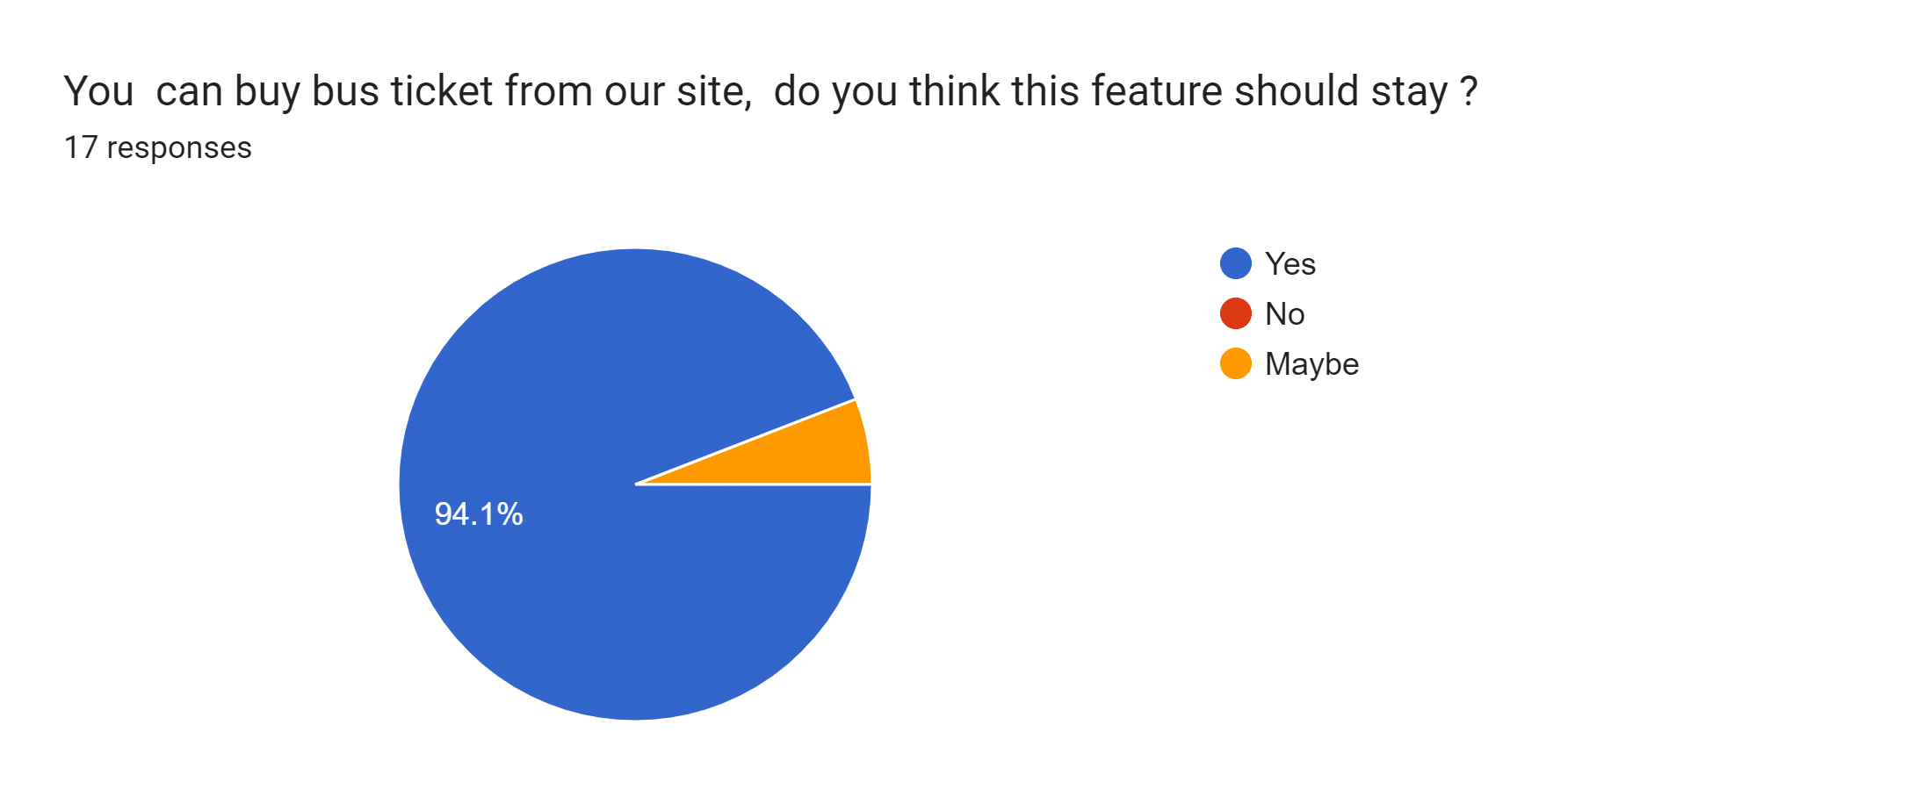
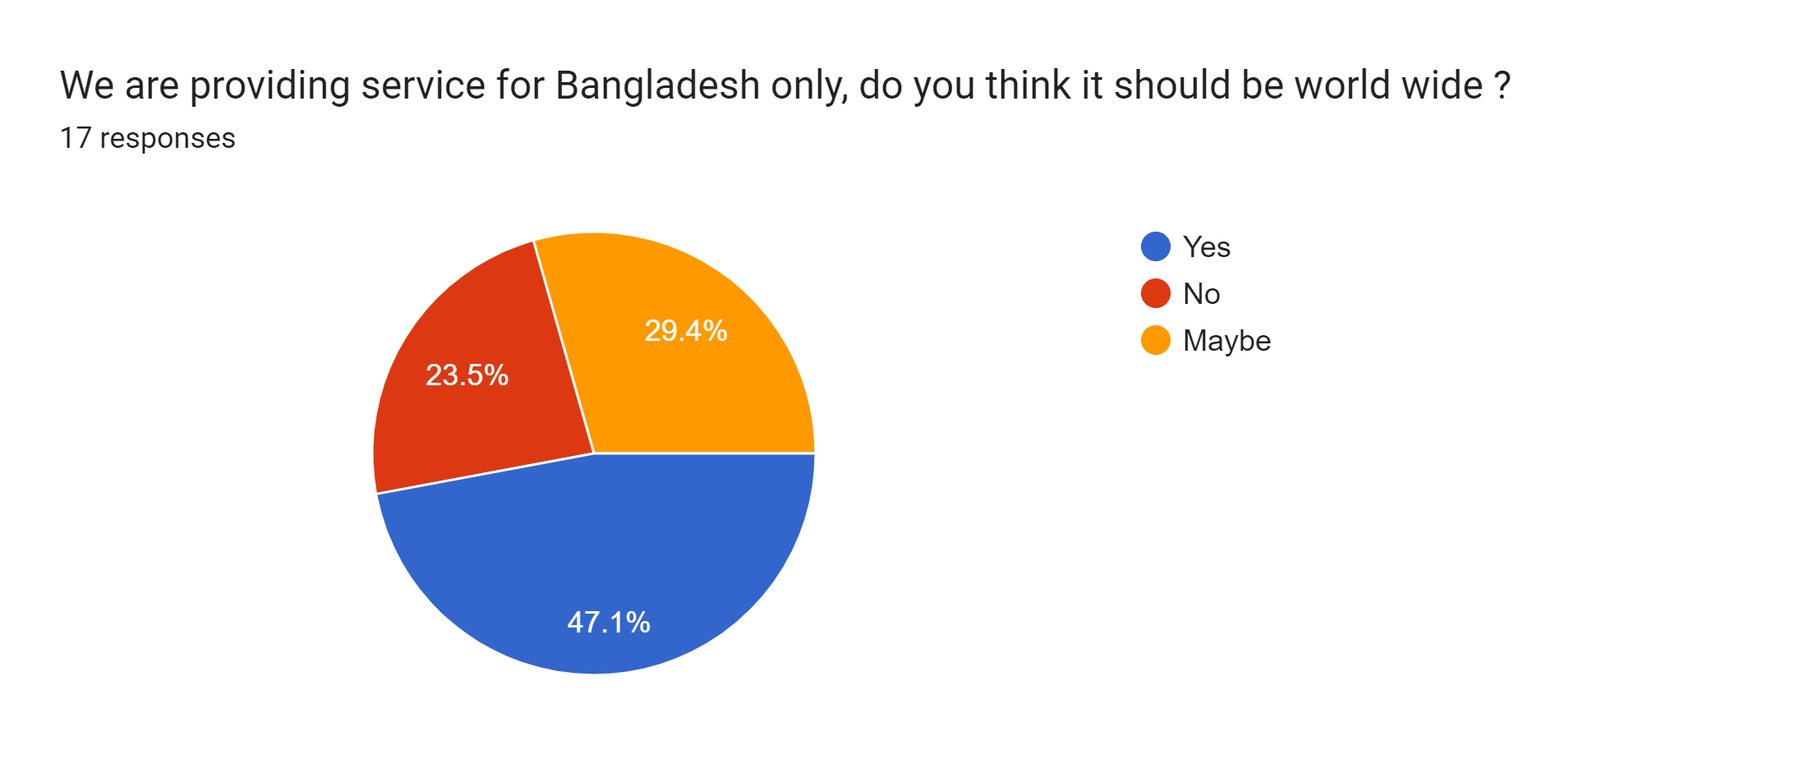
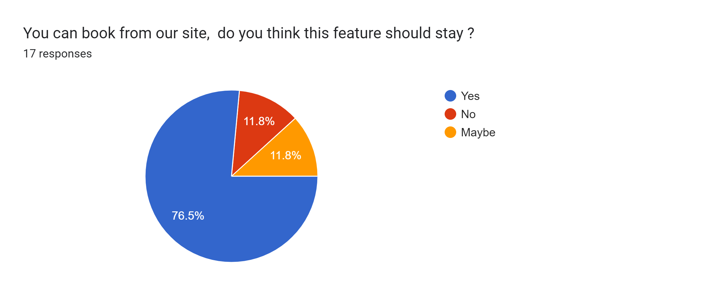
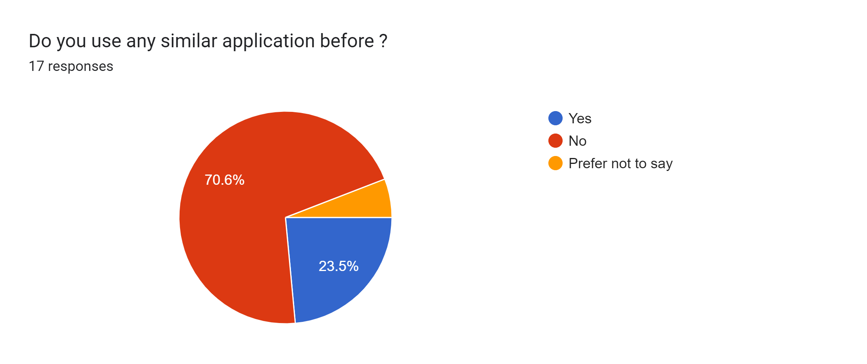
Survey:

Slide 14
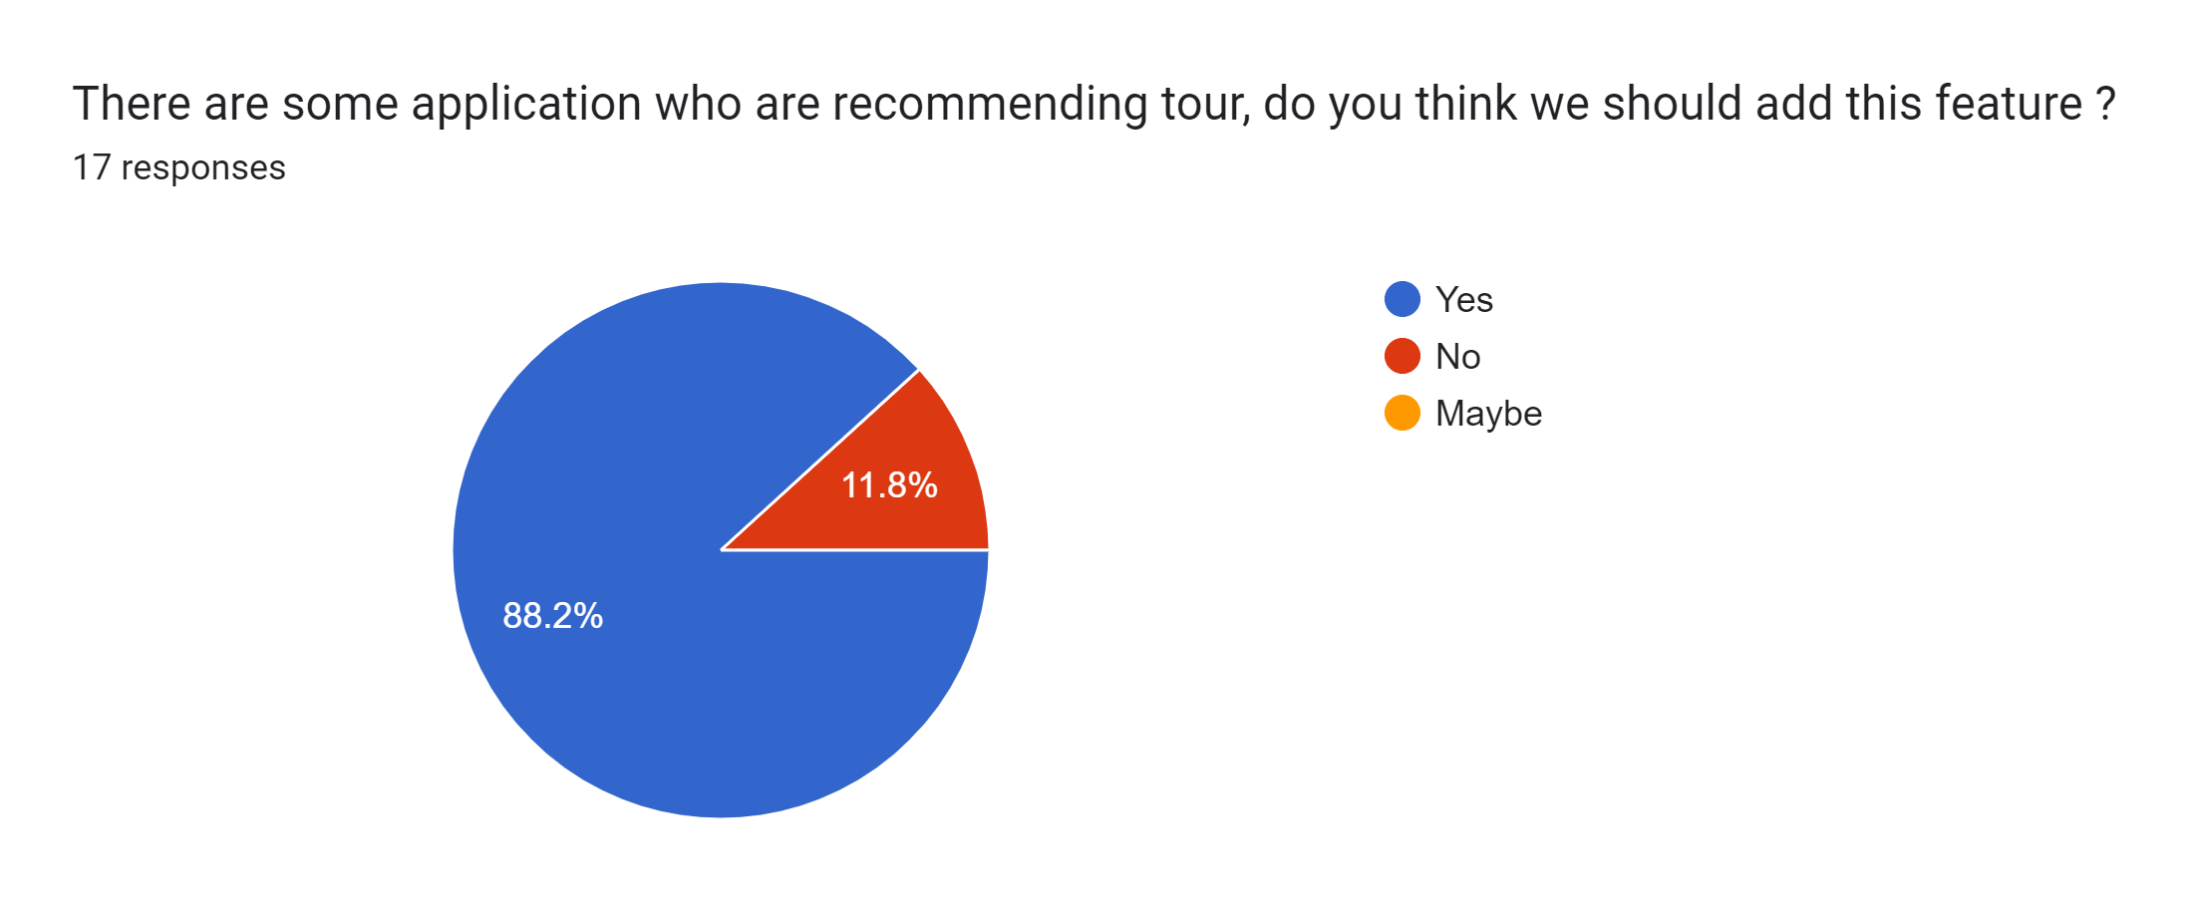
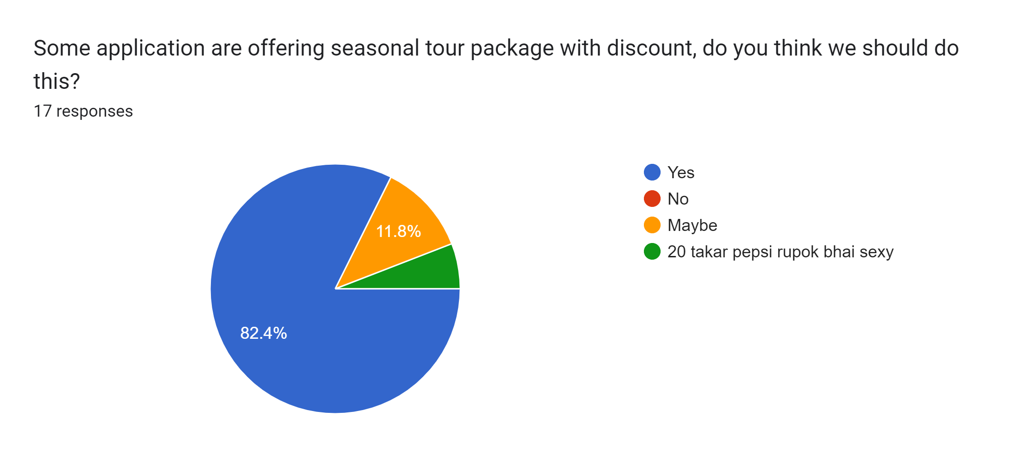

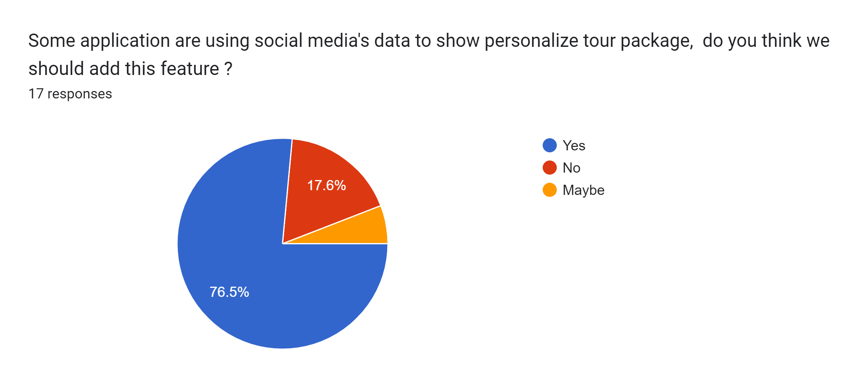
Survey:

Slide 15
GAP Analysis:
•Effective Recommendation
🡪 There is no such application which can actually recommend any tourist spot
of Bangladesh based on social media’s info or the information provided by
the user, so we are trying to work on this.
•Weather Update
🡪 when a user make a tour plan by our system, it will tell the user about the weather condition of that place, by this info a user can make his/her tour more hassle free.

Slide 16
Feature List:
Tour Suggestion
Weather Condition
Bus Ticket
Hotel Ticket
Reading books while travelling
ChatBot
Travel package recommendation

Slide 17
Stakeholders:
User
Admin
Bus company through API
Hotel owners through API

Slide 18
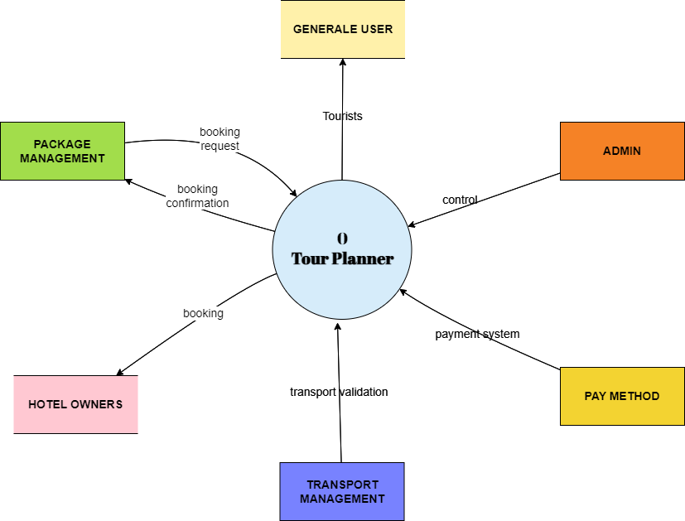
Context Diagram:

Slide 19
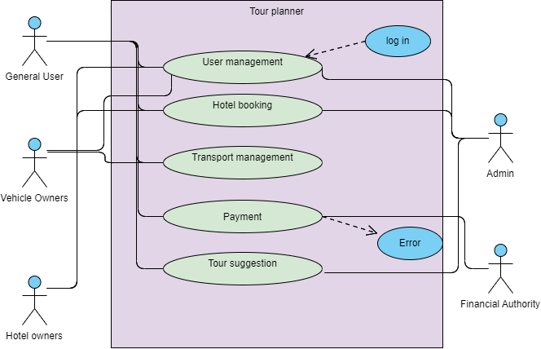
Use-Case Diagram:

Slide 20
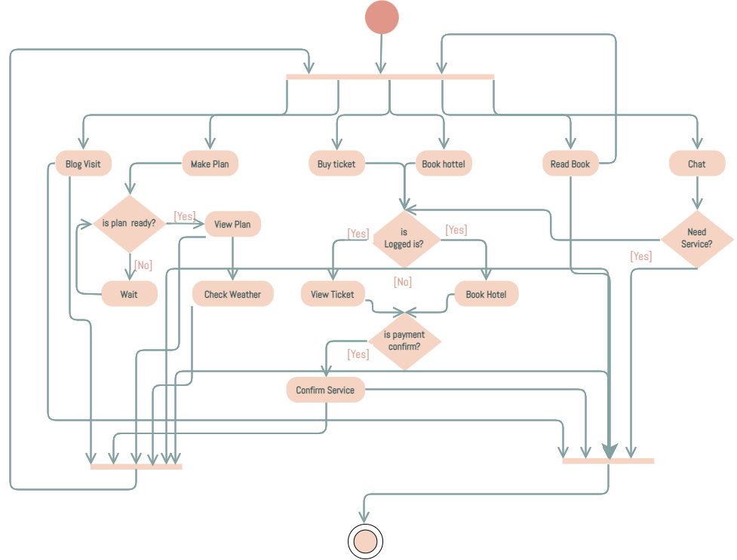
Activity Diagram:

Slide 21
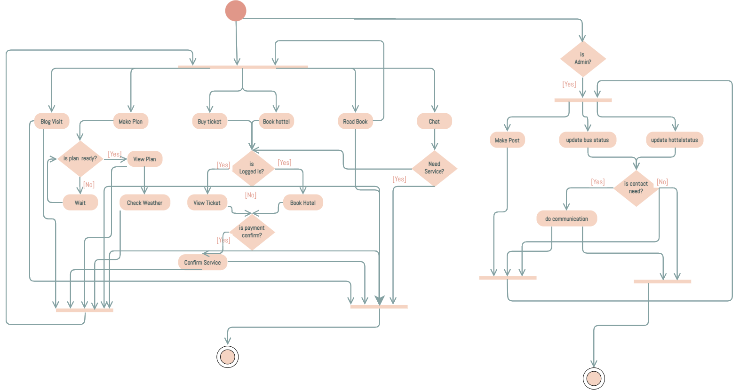
Swimlane Diagram:
General User
Admin

Slide 22
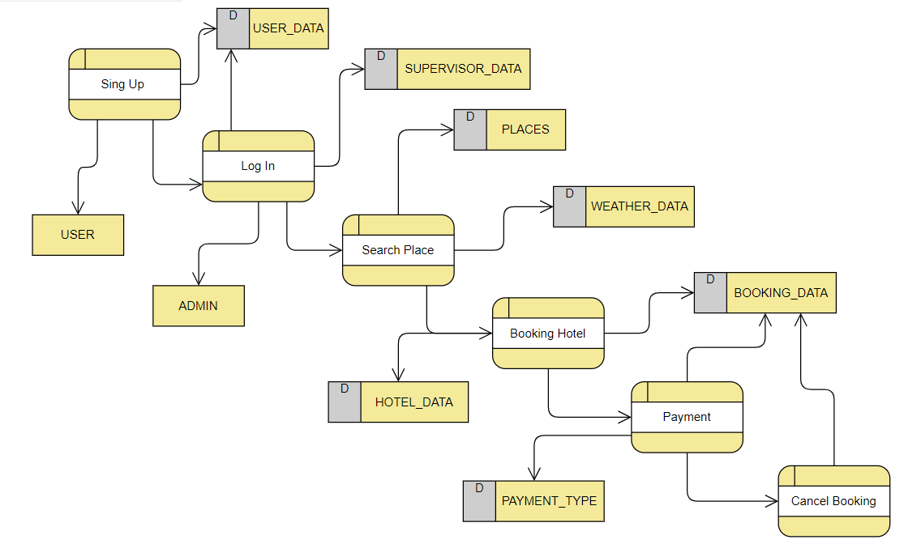
Data Flow Diagram:

Slide 23
Group Members:
Hasibul Hasan Rupok(011201002)
Mahmudul Hasan Bipul (011201025)
Md Muntasir Jahid Ayan (011201439)
Shah Newaz Aziz (011201437)
Sanjida Jannat Anannaya(011201440)

Slide 24
Group Members Contribution:
Name | ID | Contribution
Hasibul Hasan Rupok | 011201002 | Slide, Gap analysis, Activity Diagram, Swimlane Diagram, Survey
Mahmudul Hassan Bipul | 011201025 | Benchmark analysis, related report
Muntasir Jahid Ayan | 011201439 | Research Paper, Use case diagram, DFD, report partially
Sanjida Jannat Anannaya | 011201440 | Research Paper, Context diagram, report writing
Shaw Newaz Aziz | 011201437 | Benchmark Analysis

Slide 25

Thank You

